Slide 1
APPROACH TO VASCULITIS..
PRESENTER- Dr. B. PRADEEP.
CHAIR PERSON- Dr. T. SMRUTHI.

Slide 2
Vasculitis are group of disorders characterized by immunoinflammatory injury to vessel wall leading to aneurysm, bleeding, stenosis, occlusion, thrombosis, embolism and ischemia.
Clinical manifestations are protean depending upon size, site and type of vessel involved in different organs and upon the underlying disease.
Severity of vasculitis varies from benign self limiting vasculitis to severe life threatening systemic vasculitis.

Slide 3
CASE 1.. A 27-year- old tailor complained of numbness on the volar aspect of his thumb and the two neighboring fingers on the right hand. Over the ensuing days,“the general weakness increased so rapidly that he was unable to leave the bed, the feeling of numbness also appeared in the left hand.” The patient’s weakness,was accompanied by tachycardia, abdominal pains, and the appearance of cutaneous nodules over his trunk.
At autopsy, grossly visible nodules were present along the patient’s medium-sized arteries.
Kussmaul and Maier suggested the name “periarteritis nodosa.”

Slide 4
GENERAL DIAGNOSTIC APPROACH..
Is this a condition that could mimic the presentation of vasculitis?
Is there a secondary underlying cause?
What is the extent of vasculitis?
How do I confirm the diagnosis of vasculitis?
What specific type of vasculitis is this?

Slide 5
Vasculitis ‘‘mimics’’ should be excluded first..
CASE 2.. A 48 year old man, an injecting drug user, presented with a four week history of generally feeling unwell and purpuric rash over both legs.
He looked ill, and there were several nail fold infarcts and vasculitic lesions over the pulps of his fingers.
Blood picture was in keeping with systemic inflammatory response.
Chest radiography showed two separate cavitating lesions in the right lung.
Skin biopsy showed leucocytoclastic vasculitis.
His illness was initially attributed to systemic vasculitis and specialist opinion was sought.

Slide 6
INFECTION IS A GREAT MIMIC OF VASCULITIS..
Bacterial endocarditis.
Disseminated gonococcal infection.
Pulmonary histoplasmosis.
Coccidioidomycosis.
Syphilis.
Lyme disease.
Rocky Mountain spotted fever.
Whipple’s disease.

Slide 7
Possible secondary causes of vasculitis should be excluded..
Vasculitis associated with probable etiology..
Drug-induced vasculitis
Hepatitis C virus.
Hepatitis B virus.
Cancer-associated vasculitis
Vasculitis associated with systemic disease..
Lupus vasculitis.
Rheumatoid vasculitis.
Sarcoid vasculitis

Slide 8
Extent of vasculitis should be assessed..
It is important to assess the extent of vasculitis, and look for internal organ involvement even in patients who seem to have isolated cutaneous vasculitis.
CASE 3.. A combination therapy with cyclophosphamide and methylprednisolone is offered to those with renal involvement in Wegener’s granulomatosis to prevent progression to end stage renal disease.
Even co-trimoxazole is sufficient treatment for some patients with disease limited to the upper respiratory tract.
CASE 4.. A patient with giant cell arteritis. PULSE YES / NO??

Slide 9
To confirm diagnosis of vasculitis..
The site to be biopsied depends on clinical presentation.
Common favoured sites include skin, kidney, temporal artery, muscle, nasal mucosa, lung, nerve.
In patients with skin and renal involvement??
Blind biopsies to ‘‘exclude vasculitis’’ in patients with non-specific generalised systemic symptoms are usually unhelpful.
Biopsy findings might sometimes not be helpful even in patients with definite vasculitis.
Histological examination could be normal in around 45%.

Slide 10
Radiological..
If tissue diagnosis is impractical (patients with large or medium vessel vasculitis with no accessible tissue for obtaining histological proof) angiogram should be considered.
Mesenteric and coeliac axis angiograms are useful in patients with suspected gastrointestinal tract vasculitis.
Renal angiogram is useful in those with suspected renal artery involvement.
BUT IN GLOMERULONEPHRITIS???
Magnetic resonance angiogram of the thoracic aorta is the investigation of choice in patients with suspected large vessel vasculitis such as Takayasu’s arteritis.

Slide 11
To identify the specific type of vasculitis..
The first step towards identifying the specific type of vasculitis is to categorise them according to the size of the affected vessel.
LARGE VESSEL..
Aorta and its major branches..
MEDIUM VESSEL..
Smaller than the major aortic branches..
SMALL VESSEL..
Capillaries, postcapillary venules, and arterioles..
Large enough to contain four elements intima, continous internal elastic lamina, muscular media and an adventitia..
Such vessels are typically less than 500 μ in outer diameter..

Slide 12
Typical manifestations..
LARGE VESSEL..
Limb claudication.
Asymmetric blood pressure.
Absence of pulses.
Bruits.
MEDIUM VESSEL..
Red ,blue subcutaneous nodules(Panniculitis).
Ulcers.
Livedo reticularis.
Digital gangrene.
Mononeuritis multiplex.

Slide 13
SMALL VESSEL..
Purpura.
Vesicobullous lesions.
Urticaria.
RENAL- Glomerulonephritis & renal failure.
LUNG- Alveolar hemorrhage.
Splinter hemorrhages.
EYE- Uveitis, episcleritis, scleritis.
Mucosal ulcers in bowel.
Cutaneous extravascular necrotizing granulomas.

Slide 14
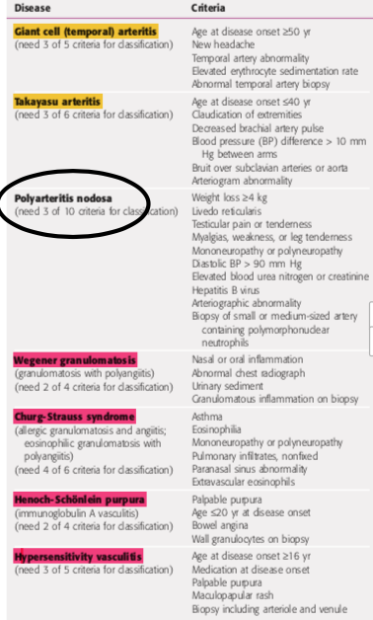
CLASSIFICATION OF VASCULITIS..
The most widely used classification system is the 1990 American College of Rheumatology (ACR) Criteria for the Classification of Vasculitis.
CLASSIFIED ONLY 7 VASCULITIS.
NO ANCA..

Slide 15
INTERNATIONAL CHAPEL HILL CONSENSUS CONFERENCE ON THE NOMENCLATURE OF VASCULITIDES..
LARGE-VESSEL VASCULITIS (LVV)..
Takayasu arteritis (TAK).
Giant cell arteritis (GCA).
Behcets disease (BD).
Cogan syndrome (CS).
Medium-vessel vasculitis (MVV)..
Polyarteritis nodosa (PAN).
Kawasaki disease (KD).
Cutaneous PAN.
T.A.O.
Variable-vessel vasculitis (VVV)..
Behçet disease (BD).
Cogan syndrome (CS).

Slide 16
Small-vessel vasculitis (SVV)..
ANCA associated vasculitis (AAV)..
Microscopic polyangiitis (MPA).
Granulomatosis with polyangiitis (Wegener granulomatosis) (GPA).
Eosinophilic granulomatosis with polyangiitis (Churg-Strauss vasculitis) (EGPA).
Immune complex SVV..
Anti–glomerular basement membrane (anti-GBM) disease.
Cryoglobulinemic vasculitis (CV).
Immunoglobulin A vasculitis (Henoch-Schonlein purpura) (IgAV).
Hypocomplementemic urticarial vasculitis (anti-C1q vasculitis).

Slide 18
ANCA..
Antibodies directed against certain proteins in the cytoplasmic granules of neutrophils and monocytes.
There are two major categories of ANCA based on different targets for the antibodies.
cytoplasmic ANCA (cANCA).
Proteinase-3,a 29-kDa neutral serine proteinase present in neutrophil azurophilic granules, is the major cANCA antigen.
ANCA (cANCA) refers to the diffuse, granular cytoplasmic staining pattern observed by immunofluorescence microscopy when serum antibodies bind to indicator neutrophils.

Slide 19
Perinuclear ANCA (pANCA).
Major target for pANCA is the enzyme myeloperoxidase in monocytes.
pANCA refers to the more localized perinuclear or nuclear staining pattern of the indicator neutrophils.
Other targets that can produce a pANCA pattern of staining include elastase, cathepsin G, lactoferrin, lysozyme, and bactericidal/permeability-increasing protein.

Slide 20
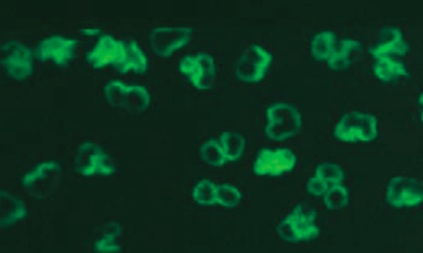
Granular pattern of fluorescence
(c-ANCA)..
Perinuclear pattern p ANCA ..

Slide 21
C-ANCA..
GPA- 70%.
MPA-40%.
Renal limited vasculitis- 20%.
EGPA- 5%.
P-ANCA..
Renal limited vasculitis-70%.
MPA- 50%.
EGPA- 40%.
GPA- 25%.
FALSE POSITIVE ANCA- Ag is not MPO..
R.A.
I.ENDOCARDITIS.
IBD.
AIH.
GOOD PASTEUR SYNDROME.
P.S.C.
CYSTIC FIBROSIS.
ANCA TITRES DONOT CORRELATE WITH SEVERITY..

Slide 22
INTERNATIONAL CHAPEL HILL CONSENSUS CONFERENCE ON THE NOMENCLATURE OF VASCULITIDES..

Slide 23
GIANT CELL ARTERITIS..
Giant cell arteritis, historically referred to as temporal arteritis, is an inflammation of medium and large sized arteries.
It characteristically involves one or more branches of the carotid artery, particularly the temporal artery.
Superficial temporal artery >> vertebral artery >> ophthalmic artery>> posterior ciliary artery.
In India mean age of anset is >70yrs, more common in women than in men and an association with HLA-DR4.

Slide 24
Histopathologically, the disease is a panarteritis with inflammatory mononuclear cell infiltrates within the vessel wall with frequent giant cell formation.
There is proliferation of the intima and fragmentation of the internal elastic lamina.
ACR CRITERIA.. Atleast 2 or more of 5.
Age at disease onset ≥ 50 yr.
New headache.
Temporal artery abnormality.
Elevated ESR.
Abnormal artery biopsy {Biopsy specimen with artery showing vasculitis characterized by a predominance of mononuclear cell infiltration or granulomatous inflammation, usually with multinucleated giant cells}.

Slide 25
CLINICAL AND LABORATORY MANIFESTATIONS..
Giant cell arteritis is most commonly characterized clinically by the complex of fever, anemia, high ESR, and headaches in a patient aged >50 years.
Headache is the predominant symptom and may be associated with a tender, thickened, or nodular artery, which may pulsate early in the disease but may become occluded later.
Scalp pain and claudication of the jaw and tongue may occur.
A dreaded complication of giant cell arteritis, particularly in untreated patients, is ischemic optic neuropathy, which may lead to serious visual symptoms even sudden blindness.
Other cranial ischemic complications include strokes and scalp or tongue infarction.

Slide 26
Polymyalgia rheumatica {PMR}..
There are no specific diagnostic tests or pathologic findings, PMR is defined by its clinical features.
Aching and morning stiffness lasting half an hour or longer in the shoulder, hip girdle, neck, or some combination.
Duration of these symptoms for 1 month or longer.
Age older than 50 years.
Laboratory evidence of systemic inflammation such as an elevated erythrocyte sedimentation rate (ESR).
10–20% of patients who initially present with features of isolated polymyalgia rheumatica later go on to develop giant cell arteritis.

Slide 27
Diagnosis..
The diagnosis can be confirmed by biopsy of the temporal artery but may not be positive in all patients due to patchy histologic findings.
Since involvement of the vessel may be segmental positive yield is increased by obtaining a biopsy segment of 3–5 cm together with serial sectioning of biopsy specimens.
Large-vessel disease may be suggested by symptoms and findings on physical examination such as diminished pulses or bruits.

Slide 28
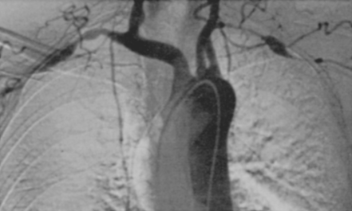
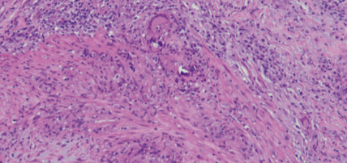
Short segments of curved artery..
Subclavian and axillary arteries are affected..
Cross-section of a temporal artery showing transmural inflammation with mononuclear cells and giant cells..

Slide 29
Treatment should begin with prednisone, 40–60 mg/d for ~1 month, followed by a gradual tapering.
Patients require treatment for ≥2 years.
Symptom recurrence during prednisone tapering develops in 60–85% of patients with giant cell arteritis, requiring a dosage increase.
The esr can serve as a useful indicator of inflammatory disease activity in monitoring and tapering therapy.
Tocilizumab (anti-il-6 receptor) was found to be more effective than prednisone alone.

Slide 30
TAKAYASU’S ARTERITIS.. also known as pulseless disease or occlusive thromboaortopathy..
It is an inflammatory and stenotic disease of medium- and large-sized arteries characterized by a strong predilection for the aortic arch and its branches.
Age of onset < 40 yrs with Female to Male ratio 9:1. Strongly associated with HLA DW52.
The involvement of the major branches of the aorta is much more marked at their origin than distally.
The disease is a panarteritis with inflammatory mononuclear cell infiltrates and occasionally giant cells.

Slide 31
CLINICAL..
ACR Criteria for Takayasu’s Arteritis..
Onset before age 40 yr.
Limb claudication.
Decreased brachial artery pulse.
Unequal arm blood pressure (>10 mm hg).
Subclavian or aortic bruit.
Angiographic evidence of narrowing or occlusion of aorta or its primary branches, or large limb arteritis
3 or more..

Slide 32
The diagnosis is confirmed by the characteristic pattern on arteriography. Features includes irregular vessel walls, stenosis, poststenotic dilation, aneurysm formation, occlusion, and evidence of increased collateral circulation.

Slide 33
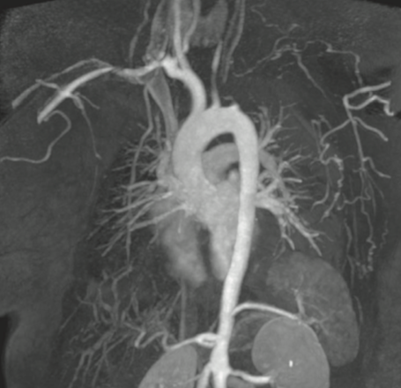
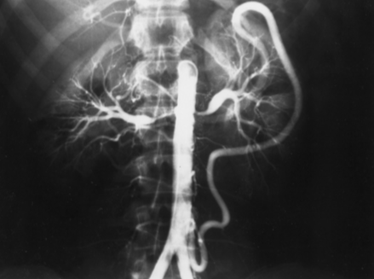
RADIOLOGY..

Slide 34
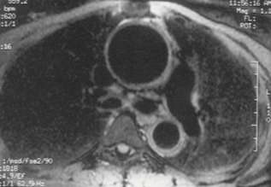

Slide 35
TREATMENT..
Disease-related mortality most often occurs from congestive heart failure, cerebrovascular events, myocardial infarction, aneurysm rupture, or renal failure.
Glucocorticoid therapy in doses of 40–60 mg prednisone per day alleviates symptoms, there are no convincing studies that indicate that it increases survival.
Combination of glucocorticoid therapy for acute signs and symptoms and an aggressive surgical and/or arterioplastic approach to stenosed vessels.
Individuals who are refractory to or unable to taper glucocorticoids, methotrexate in doses up to 25 mg per week.
Results with anti-TNF therapies and tocilizumab have been encouraging.

Slide 36
Bechet’s Syndrome..
Bechet’s syndrome is a multisystem disorder presenting with recurrent oral and genital ulcerations as well as ocular involvement.
Males and females are affected equally.
Males often have more severe disease.
The main pathologic lesion is systemic perivasculitis with early neutrophil infiltration and endothelial swelling.
Circulating autoantibodies against α-enolase of endothelial cells, selenium binding protein, and anti-Saccharomyces cerevisiae antibodies have been observed.
Genome-wide association study confirmed the known association of Behçet’s syndrome with HLA-B*51.

Slide 37
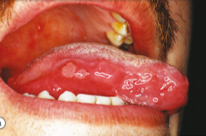
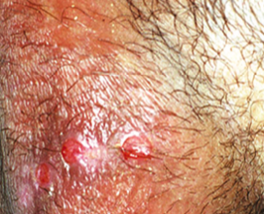
Ulcers are usually painful, shallow or deep with a central yellowish necrotic base, appear singly or in crops.
Small ulcers, <10 mm in diameter, are seen in 85% of patients.
Ulcers subside without leaving scars.
Genital ulcers are less common but more specific.
Painfull.
Do not affect the glans penis or urethra.
Heal with scrotal and vulvar scars.

Slide 38
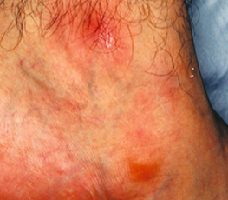
Skin involvement is observed in 80% of patients and includes folliculitis, erythema nodosum, acne-like rashes, vasculitis, Sweet syndrome, and pyoderma gangrenosum.

Slide 39
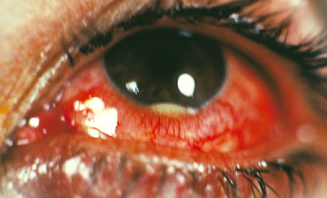
The pathergy reaction represents hyperreactivity of the skin to trauma.
Typically, it is characterized by erythematous papule or pustule formation at a skin site 24 to 48 hours after insertion of the needle.
This phenomenon is quite specific for Behçet syndrome.
wound healing after biopsy-induced trauma is normal.
Eye involvement with scarring and bilateral panuveitis is the most dreaded complication.
Uveitis occurs in 10–15% of patients, primarily in males.
In addition to iritis, posterior uveitis, retinal vessel occlusions, and optic neuritis can be rarely seen in some patients.

Slide 40
Recurrent oral ulceration plus two of the following:
Recurrent genital ulceration.
Ocular lesions.
Skin lesions.
Positive Pathergy test.
Revised International Criteria for Behçet’s Disease..

Slide 41
JOINT- Non-deforming arthritis or arthralgias are seen in 50% of patients and affect mostly the knees and ankles.
Why BECHET’s is life Threatening??
Superficial or deep peripheral vein thrombosis is seen in 30% of patients.
Arterial involvement occurs in <1–5% of patients and presents with aortitis or peripheral arterial aneurysm and arterial thrombosis.
“Central nervous system [CNS]- Behçet’s syndrome” - Neurologic involvement (5–10%) appears mainly in the parenchymal form (80%).
It is associated with brainstem involvement and has a grave prognosis.
CerebraL venous thrombosis is more common in female patients.
IL-6 is persistently raised in cerebrospinal fluid of these patients.
Cerebral venous thrombosis is most frequently observed in the superior sagittal and transverse sinuses.

Slide 42
TREATMENT..
Mucous membrane involvement may respond to topical glucocorticoids in the form of mouthwash or paste.
More serious cases thalidomide (100 mg/d) is effective.
Recently it was shown that Apremilast, an inhibitor of phosphodiesterase-4, was effective for oral ulcers.
Colchicine can be beneficial for the mucocutaneous manifestations and arthritis.
Uveitis and CNS- Behçet’s syndrome require systemic glucocorticoid therapy (prednisone, 1 mg/kg per day), azathioprine (2–3 mg/kg per day) and cyclosporine (2–5 mg/kg).

Slide 43
SMALL VESSEL VASCULITIS..
GPA [WAGENERS]= NVFN + GRANULOMA..
MPA= NVFN – GRANULOMA.
EGPA/AGPA= NVFN + TISSUE EOSINOPHILIA + EXTRAVASCULAR GRANULOMA.
NECROTIZING VASCULITIS WITH FIBRINOID NECROSIS..
NVFN..

Slide 44
GRANULOMATOSIS WITH POLYANGITIS (WEGENER’S)..
It is characterized by granulomatous vasculitis of the upper and lower respiratory tracts together with glomerulonephritis.
Mean age of onset is 40 years, male-to-female ratio is 1:1.
3 MAJOR.. 3 MINOR..
95%- URT involvement. 1. Eye- Anterior uveitis.
90%- LRT involvement. 2. Skin- petechiae, purpura.
60%- Renal. 3. Neuropathy.

Slide 45
URT..
Bilateral serous otitis media.
Mid line nasal deformities{septal perforation}.
Recurrent sinusitis.
Subglottic stenosis.
LRT..
Cough with hemoptysis secondary to-
Thick walled cavitating nodules or DAH.
Renal..
Presents as RPRF with oliguria, edema, raising serum creatinine.

Slide 46
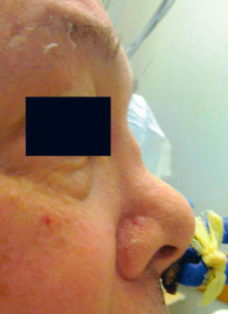
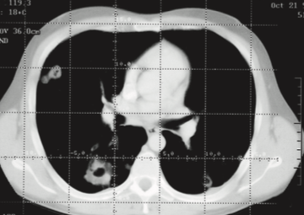

Slide 47
90% of patients with active granulomatosis with polyangiitis (Wegener’s) have a positive antiproteinase-3 ANCA.
Pulmonary tissue offers the highest diagnostic yield, almost invariably revealing granulomatous vasculitis.
Biopsy of upper airway tissue usually reveals granulomatous inflammation with necrosis but may not show vasculitis.
Renal biopsy can confirm the presence of pauciimmune glomerulonephritis.
Presence of ANCA should be adjunctive and, with rare exceptions, should not substitute for a tissue diagnosis.

Slide 48
MICROSCOPIC POLYANGIITIS {MPA}..
Presence of glomerulonephritis in patients with polyarteritis nodosa.
A necrotizing vasculitis with few or no immune complexes affecting small vessels (capillaries, venules, or arterioles).
Glomerulonephritis is very common in microscopic polyangiitis, and pulmonary capillaritis often occurs.
The absence of granulomatous inflammation in microscopic polyangiitis is said to differentiate it from granulomatosis with polyangiitis (Wegener’s).
The mean age of onset is ~57 years, and males >> Females.

Slide 49
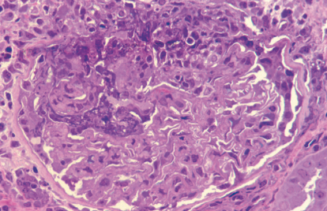
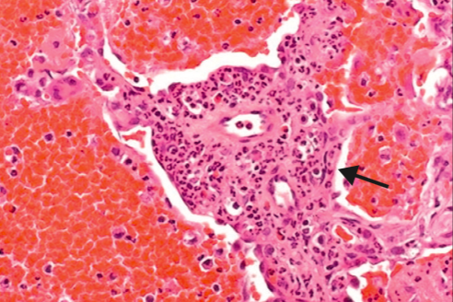
3 MAJOR.. 3 MINOR..
100%- Renal involvement. 1. Eye- Anterior uveitis.
50%- LRT involvement. 2. Skin- petechiae, purpura.++++
30%- URT involvement. 3. Mesenteric vasculitis>> neuropathy.
LRT involvement in the form of DAH.
NODULES AND CAVITIES are not seen.

Slide 50
The renal lesion seen in microscopic polyangiitis is identical to that of granulomatosis with polyangiitis (Wegener’s).
Like granulomatosis with polyangiitis (Wegener’s), microscopic polyangiitis is highly associated with the presence of ANCA, which may play a role in pathogenesis of MPA.

Slide 51
EOSINOPHILIC GRANULOMATOSIS WITH POLYANGIITIS (CHURG-STRAUSS).. EGPA / AGPA..
Described in 1951 by Churg and Strauss and is characterized by asthma, peripheral and tissue eosinophilia, extravascular granuloma formation, and vasculitis of multiple organ systems.
The mean age of onset is 48 years, with a female-to-male ratio of 1.2:1.
Characteristic histopathologic feature of eosinophilic granulomatosis with polyangiitis (Churg-Strauss) is granulomatous reactions that may be present in the tissues or even within the walls of the vessels themselves.
These are usually associated with infiltration of the tissues with eosinophils.

Slide 52
Typically a patient of EGPA passess through 3 stages..
PRODROMAL PHASE { ALLERGIC / ASTHMATIC PHASE}.
A 10 – 20yr male presents with Atopic rhinitis or Asthma which is not easy controlled with medications and with frequents exacerbations despite adequate and proper medication and its use.
EOSINOPHILIC PHASE.
Characterised by blood and tissue eosinophilia with fleeting pulmonary opacities.
VASCULITIC PHASE.
Painfull peripheral neuropathies.
Mesenteric vasculitis.
Renal RPRF presentation.
Cardiovascular{ Mc cause of death}.
After 10 yrs..

Slide 53
The five factor score for prognosis..
Proteinuria > 1 g/24 h.
Creatininemia > 140 µmol/L.
Specific gastrointestinal involvement.
Specific cardiomyopathy.
Specific CNS involvement.
Patients with eosinophilic granulomatosis with polyangiitis (Churg- Strauss) often exhibit nonspecific manifestations such as fever, malaise, anorexia, and weight loss.
Mononeuritis multiplex is the second most common manifestation and occurs in up to 72% of patients.

Slide 54
The characteristic laboratory finding in virtually all patients with eosinophilic granulomatosis with polyangiitis (Churg-Strauss) is a striking eosinophilia, which reaches levels >1000 cells/μL in >80% of patients.
Mesenteric angiitis, potentially leading to ischemia-induced bowel perfora- tion, can be seen in up to 20% of EGPA patients.
Cardiac involvement is far more common in EGPA (approximately 50%).

Slide 56
MEDIUM VESSEL VASCULITIS..{P.A.N}
“Necrotizing inflammation of medium-sized or small arteries without glomerulonephritis or vasculitis in arterioles, capillaries, or venules.”
ADA 2 def has been associated with PAN.
Hep-B association { 30 : 1 } rule.
Hairy cell leukemia association.
Lesions are segmental and tend to involve bifurcations and branchings of arteries.
They may spread circumferentially to involve adjacent veins.
As the lesions heal, there is collagen deposition, which may lead to further occlusion of the vessel lumen.
Aneurysmal dilations up to 1 cm in size along the involved arteries are characteristic of polyarteritis nodosa.

Slide 57
Pathology in the kidney in classic polyarteritis nodosa is that of arteritis without glomerulonephritis.
In polyarteritis nodosa, renal involvement most commonly manifests as hypertension, renal insufficiency, or hemorrhage due to microaneurysms.
Pulmonary arteries are not involved in polyarteritis nodosa.

Slide 58
The diagnosis of polyarteritis nodosa is based on the demonstration of characteristic findings of vasculitis on biopsy material of involved organs.
In the absence of easily accessible tissue for biopsy, the arteriographic demonstration of aneurysms of small- and medium-sized arteries in the renal, hepatic, and visceral vasculature, is sufficient to make the diagnosis.
Biopsy of symptomatic organs such as nodular skin lesions, painful testes, and nerve/muscle provides the highest diagnostic yields.

Slide 59
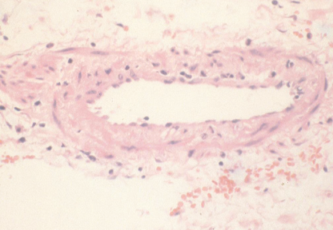
Transmural inflammation with infiltrating lymphocytes..

Slide 60
Treatment of hepatitis B–related PAN with steroids plus an antiviral agent plus plasmapheresis resulted in 81% of patients achieving remission and a subsequent 10% relapse rate.
Plasmapheresis achieved not only a control of disease in combination with steroids and antiviral therapy but facilitated seroconversion to prevent secondary long-term complications from HBV infections such as liver involvement.

Slide 61
Kawasaki disease {infantile periarteritis nodosa, mucocutaneous lymph node syndrome}..
Children younger than 5 years, boys >> girls.
CLINICAL CRITERIA FOR CLASSIC KAWASAKI DISEASE..
Fever persisting at least 4 days in the presence of four of five principal clinical criteria:
Polymorphous rash.
Bilateral conjunctival injection without exudate.
Changes in the oropharynx, including red fissured lips, strawberry tongue, and red pharynx without exudate.
Changes in the extremities, including edema of the dorsa of the hands and feet, palm and sole erythema, and periungual desquamation during the convalescent stage (usually 2 to 3 weeks after fever onset).
Enlarged cervical lymph node of at least 1.5 cm (usually unilateral).

Slide 62
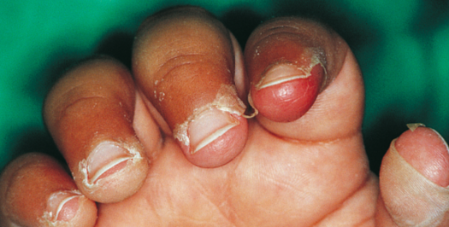
The exanthem can take many different forms but is never frankly bullous or vesicular.
The rash is not pruritic.
Micropustules (less than 1 mm) may occur over extensor surfaces, genitals, and the upper buttocks.
The rash is accentuated in the groin in 50% of patients.
Changes in the extremities include edema of the dorsa of hands and feet and palm and sole erythema.
Periungual desquamation may occur on the fingers or toes is noted in two thirds of patients.
Arthritis of the small joints of the fingers is common and is often associated with a bluish discoloration over the proximal interphalangeal joints.

Slide 63
A painful, unilateral cervical lymph node mass is noted in approximately one third of patients.
Imaging studies show a “cluster of grapes” appearance of the node mass, in contrast with the more common single, hypodense node associated with localized bacterial infection.
KD patients with cervical node enlargement tend to have higher levels of inflammatory markers than patients with bacterial infection.
Other clinical manifestations of KD may include-
Gastrointestinal manifestations including hydrops of the gallbladder and pancreatitis, urethritis, facial nerve palsy (rare), and sensorineural hearing loss (fewer than 1% of cases).

Slide 65
Current recommended treatment for KD patients is a single intravenously administered dose of immunoglobulin (IVIG, 2 g/kg) in conjunction with high-dose aspirin (80 to 100 mg/kg/day).
After cessation of fever, reduce the aspirin dosage to a low antiplatelet dosage of 3 to 5 mg/kg/day.
Aspirin is continued until the ESR and platelet count have returned to the normal range.
This approach, if implemented within the first 10 days after fever onset, reduces the incidence of coronary artery aneurysms from 25% to 5%.
IVIG resistance, defined as persistent or recrudescent fever (temperature of 38.0° C or higher) at least 36 hours after the end of the initial IVIG infusion, can occur in patients at highest risk of coronary artery damage.
Single infusion of infliximab, corticosteroids, cyclosporine, and plasmapheresis.

Slide 66
Immune complex–mediated small vessel vasculitis..
IgA vasculitis (Henoch-Schonlein)- a small-vessel vasculitis characterized by palpable purpura (most commonly distributed over the buttocks and lower extremities), arthralgias, gastrointestinal signs and symptoms, and glomerulonephritis.
IgA vasculitis (Henoch-Schonlein) is usually seen in children most patients range in age from 4 to 7 years.
A number of inciting antigens have been suggested including upper respiratory tract infections, various drugs, foods, insect bites, and immunizations.
IgA is the antibody class most often seen in the immune complexes and has been demonstrated in the renal biopsies of these patients.

Slide 67
Laboratory studies generally show a mild leukocytosis, a normal platelet count, and occasionally eosinophilia.
Serum complement components are normal and IgA levels are elevated in about one-half of patients.
Skin biopsy specimen can be useful in confirming leukocytoclastic vasculitis with IgA and C3 deposition by immunofluorescence.

Slide 68
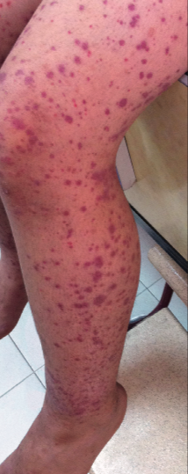
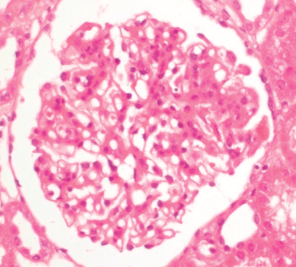
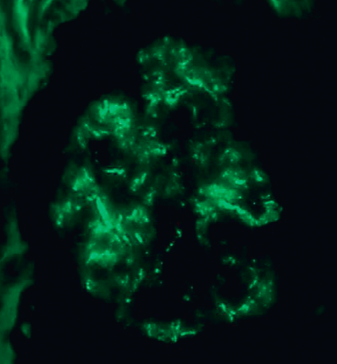
MESANGIAL PROLIFERTION..
IF GRANULAR DEPOSITS..

Slide 69
HSP..
ESSENTIAL MIXED CRYOGLOBULINEMIA..
SKIN- palpable,non thrombocytopenic purpura on extensor surfaces.
Arthritis- Large joint, migratory, Non deforming type.
Git- bowel angina, intusussception, bleeding P.R, erosive hemoorhagic duodinitis.
Renal- macroscopic hematuria.
SKIN- confluent, palpable purpura.
ARTHRITIS- Upper limb small joint, non migratory, non deforming polyarthritis.
Git symptoms less common.
RENAL- MPGN type.
Peripheral neuropathy.

Slide 70
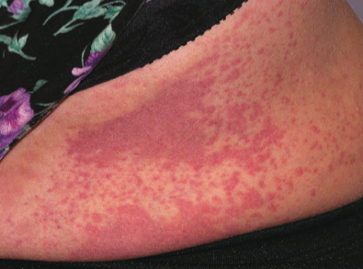
HSP..
E.M.C..

Slide 71
CRYOGLOBULINEMIA..
Cryoglobulins are immunoglobulins that precipitate at temperatures below 37°C, producing high-molecular-weight aggregates. These aggregates dissolve again when heated to temperatures above 37°C.
Cryoglobulins are best detected by drawing venous blood into a preheated syringe (37°C) and separating the serum in a centrifuge that maintains a temperature between 37°C and 39°C.
Samples with cryoprecipitates are examined daily after being centrifuged for 15 minutes.
Normal serum has been reported to contain up to 80 g/ml of cryoglobulins, whereas levels of 500 to 5,000 g/ml of cryoglobulins are frequently associated with symptoms.

Slide 72
Type I cryoglobulins are composed of one class of monoclonal immunoglobulins, most frequently IgM. | Type II cryoglobulins are mixed cryoglobulins, which are composed of a mixture of monoclonal and polyclonal immunoglobulins (monoclonal anti-IgG being the most common). | Type III cryoglobulins are composed of polyclonal immunoglobins, most commonly polyclonal IgM anti-polyclonal IgG.
Usually associated with underlying lymphoproliferative disorders including low-grade lymphomas, Hodgkins disease, Waldenströms macroglobulinemia, MGUS, angioimmunoblastic lymphadenopathy, and chronic lymphocytic leukemia. | Both type II and type III cryoglobulins are associated with lymphoproliferative disorders (indolent lymphoma, Waldenströms macroglobulinemia), autoimmune disorders (systemic lupus erythematosus, Sjögrens syndrome, scleroderma, rheumatoid arthritis), or a variety of infectious disorders | Acute and chronic hepatitis, Infectious mononucleosis Cytomegalovirus infection, Lepromatous leprosy Subacute bacterial endocarditis Syphilis Lymphogranuloma venereum.. Echinococcosis,Malaria,Toxoplasmosis Leishmaniasis,Schistosomiasis.
Patients in whom an underlying etiology cannot be identified are classified as having essential mixed cryoglobulinemia.
80% of patients with essential mixed cryoglobulinemia have mixed cryoglobulinemia secondary to an HCV infection.
Recognition that cryoglobulinemia is an HCV-related disorder lends support to the use of antiviral agents such as interferon in its treatment.

Slide 73
Rheumatoid Vasculitis..
Isolated digital vasculitis in patients with rheumatoid arthritis, characterized by splinter-like lesions in the periungual region {Bywaters’ lesions}.
These start as periungual swelling followed by skin infarcts and necrosis that leave brown eschars which disappear within a few days leaving or not (usually) a scar in the nail fold and on the ends of the digits.
Many clinical manifestations of RV are indistinguishable from polyarteritis nodosa, although microaneurysms are less common in RV.
RV classically occurs in patients with nodular, rheumatoid factor–positive, joint-destructive disease.
Deep cutaneous ulcers near the malleoli are a hallmark of RV and require scrupulous local care, as well as judicious immunosuppression.

Slide 74
Bywaters’ lesions..

Slide 75
Connective Tissue Disease–Associated Vasculitis..
CTD typically complicated by vasculitis include those related to SLE, mixed CTD, Sjogren’s syndrome, and overlap CTD.
Cutaneous vasculitis in CTDs is associated almost invariably with hypocomplementemia and high titers of antinuclear antibodies (ANAs).
DIF examination of skin lesions shows granular IgG and C3 deposition in and around dermal vessels, with or without IgM, reflecting the contribution of ICs to disease pathogenesis.
The phenomenon of the “in vivo ANA” is also observed in keratinocytes and dermal cells in DIF studies.

Slide 76
This phenomenon is caused by the binding of immunoreactants to targets within the nuclei of epidermal cells.

Slide 77
Drug Toxicity..
Cocaine.
Levamisole.
Amphetamines.
Ergot alkaloids.
Methysergide.
Arsenic.
MIMICS OF SMALL VESSEL VASCULITIS..
HYDRALAZINE.
PTU.
MINOCYCLINE.

Slide 78
Reference..
Kelly’s Rheumatology.
Hoschberg Rheumatology.
Brennets Pediatric Rheumatology.
Harrisons 20th edition.

